Slide 1
COREFERENCE RESOLUTION
KATHRIN WARDATZKY, QIAOWEN WANG, XIANXIAO XU

Slide 2
BRIEF INTRODUCTION
- PART1
mentions extraction (Tuba corpus)
mention is a single coreference phrase (consisting of one or multiple words) within a sentence. The result is a list of tuples in style like: (coref id, doc id, sent num, phrase start, phrase end).
create gold chains and gold standard
For each document, create a list for each coreference id and add to it all mentions with the respective coreference id. The output is a dictionary with the document ids as the keys and a list of lists as their values. Each internal list is a chain of coreference mentions within a document.
create features
After the coreference chains are generated, create the features( for positive and negative pairs of coreference)

Slide 3
BRIEF INTRODUCTION
- PART1I
Markables extraction
Work out markables without using true mention labels.
Model Training and Testing
data preprocessing: convert all features to numeric one and apply one-hot encoding them.
build model, training and evaluation, and testing on generated markables set.

Slide 4
Difficulties and Decisions
For feature extraction, have no idea about how to calculate distance and match different features with mentions as noun phrases.—confirm the definition of head
For Noun Phrase extraction, not clear about what kind of combination can form a noun phrase(ligustics problem)— Basically guess
For training/parameter tuning: memory issues - machines kept on dying—run the subset of training data(⅓).
gridsearchcv tuning process too slow - adjust the parameter by experience
For testing result, relative high extremely low value of recall_score and F1-score—adjust the input features and drop out some less-correlated features./tune the parameters like units of neural network in hidden layer.

Slide 5
MENTION AND GOLD CHAIN EXTRACTION
Method 1:
Extracted mentions based on the data of last column in ‘train.tueba.coref.txt’.
Followed the algorithm in lecture 5.
Used a stack to store all the mentions in the form
[coref_id,seg_id,sent,starttoken,endtoken]
Based on the segment id and coreference id to generate the gold chain
goldchains={’segment_id’:[[(coref_id,sent_id,start_token_id,end_token_id)]] }
Method II:
Mention extraction similar to method I,
[coref_id, segment, sentid1, tokenid1, (sentid2, tokenid2)]
(doc_id, sent_id, start_position, end_position, coref_id)
sorted by doc_id, sentence_id, start_pos

Slide 6
GOLD STANDARD EXTRACTION
Method 1:
Added ‘head’, ‘PoS’, ‘gramFct’ and ‘FEATS’ informations to the matching mentions.
Followed the algorithm in lecture 5 to generate positive and negative samples.
For the negative samples, difference:
Original algorithm: compare each mention between 2 coreferent mention i and mention j with the mention j
Now: comparing each neighbor mentions between mention i and j
Result : Positive samples: 79637 negative samples: 323997
Method II:
Feature extraction from “train.tueba.sync.txt”, stored in nested dict feature_dict[doc_id][sent_id][token_id] = [pos_tag, grammarfunct, head, (person, number, gender)]
Match pos_tag, grammar, head, (person, number, gender) between start- and end-token
['Label', 'Distance', 'POS1', 'Grammar1', 'POS2', 'Grammar2', 'samePOS', 'sameGrammar', 'sameHead', 'Match']
Negative Sampling: pair positive mentions with all mentions in doc until same coref_id is reached.

Slide 7
PART II
Markables extraction
Model training

Slide 8
MARKABLES EXTRACTION
Used the information from the 11th column in file ‘ test.coref.txt’ to extract all the named entity as markables.
Extracted all the noun phrase , noun and pronoun as markables based on our experience about what kind combinations STTS tag can form a noun phrase.
Combined the above two results and sorted the result based on the sentence id and segment id.
Used the information from the last column in file ‘ test.coref.txt’ to extract ture mentions.
Compared the result from step3 with the result from step4 and using window-based strategy to generate positive and negative samples.

Slide 9
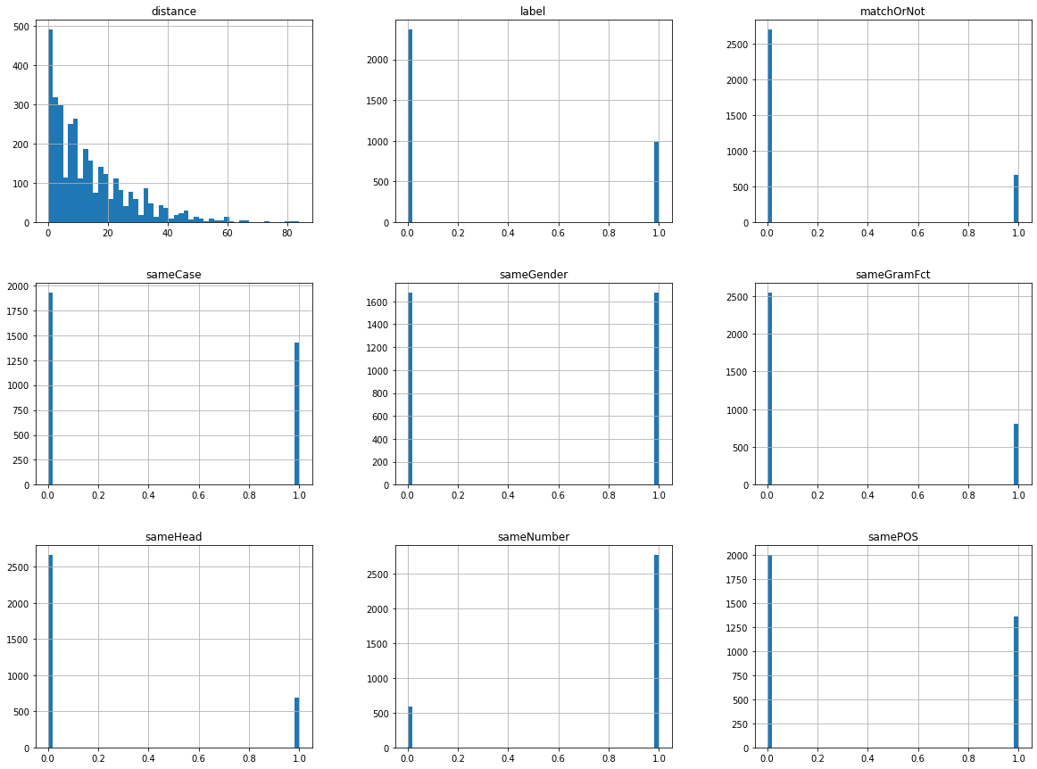
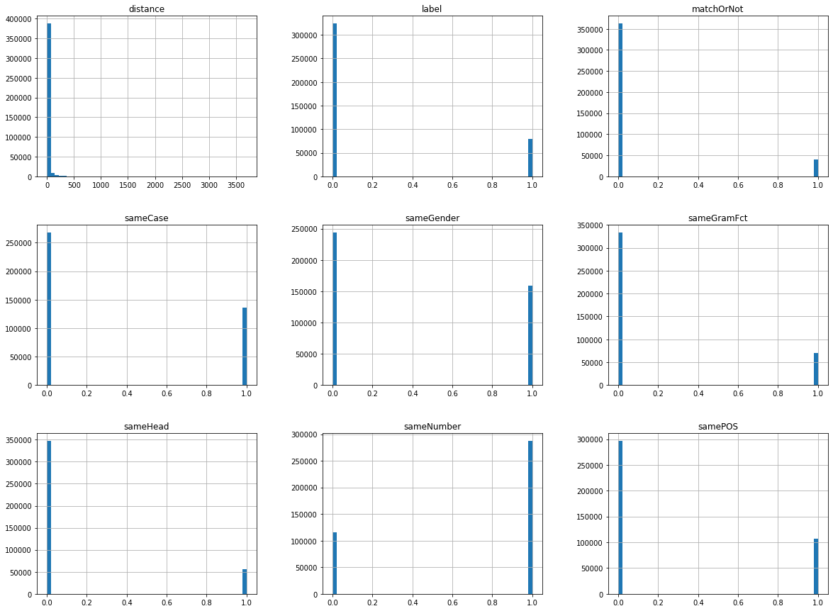
MODEL TRAINING and EVALUATION
Data preprocessing
Features: distance,POS1,gramFct1,Case1,Gender1,POS2,gramFct2,Case2,Gender2，sameHead,samePOS,sameGramFct,matchOrNot,sameCase,sameGender, sameNumber
Pipline
Label encoder and one-hot encoding
Parameter tuning method: GridSearchCV
Models
Decision Tree, SGD, Perceptron, MLP, BernoulliNB
Evaluation
cross validation (with cv=5)

Slide 10
RESULTS
features | Model | precision_score | recall_score | f1-score
 | SGD | 0 | 0 | 0
All | BernoulliNB | 0.5 | 0.43 | 0.46
All | Decision Tree | 0.37 | 0.42 | 0.39
drop sameNumber Number1 & Number2 | Decision Tree | 0.37 | 0.33 | 0.35
all | MLP(Adam) | 0.39 | 0.24 | 0.30
features | Model | precision_ score | recall_ score | f1-score
All (⅓ of train data) | SGD | 0.02 | 0.87 | 0.04
 | DT | - | - | -
 | SVM | crashes | crashes | crashes
 | Perceptron | crashes | crashes | crashes
All (⅓ of train data) | MLP | 0.006 | 0.55 | 0.01
 | KNN | didn’t finish after 7h | didn’t finish after 7h | didn’t finish after 7h

Slide 11
CONCLUDE and FURTHER IMPROVEMENT
As the limitation of time, the models (like SVM, MLP) did not finally work out results for a long training process.
The SGD predicts every data in the testset as Negative sample.(f1-score=0)
Compare with others models we have worked out the results, Naive Bayes give a relative high score.(f1-score=0.5)
Training and testing data extracted from original dataset still need to improve.(The accuracy for validation is not that high (about 60%)).
Learning NP forming rules and improve our markable extraction results.
Extract more features and try out more feature combinations.
Try out more ML models(like CNN, RNN) with more parameters combinations.

